Slide 1
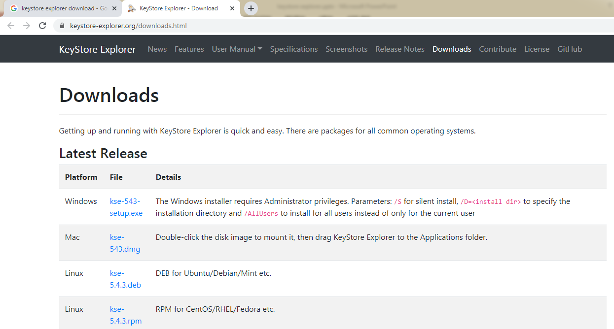
keystore explorer
https://keystore-explorer.org/downloads.html

